Slide 1
Computer Architecture
A Quantitative Approach, Sixth Edition
Chapter 7
Domain-Specific Architectures

Slide 2
Introduction
Introduction
Moore’s Law enabled:
Deep memory hierarchy
Wide SIMD units
Deep pipelines
Branch prediction
Out-of-order execution
Speculative prefetching
Multithreading
Multiprocessing
Objective:
Extract performance from software that is oblivious to architecture

Slide 3
Introduction
Introduction
Need factor of 100 improvements in number of operations per instruction
Requires domain specific architectures
For ASICs, NRE cannot be amoratized over large volumes
FPGAs are less efficient than ASICs

Slide 4
Guidelines for DSAs
Guidelines for DSAs
Use dedicated memories to minimize data movement
Invest resources into more arithmetic units or bigger memories
Use the easiest form of parallelism that matches the domain
Reduce data size and type to the simplest needed for the domain
Use a domain-specific programming language

Slide 5
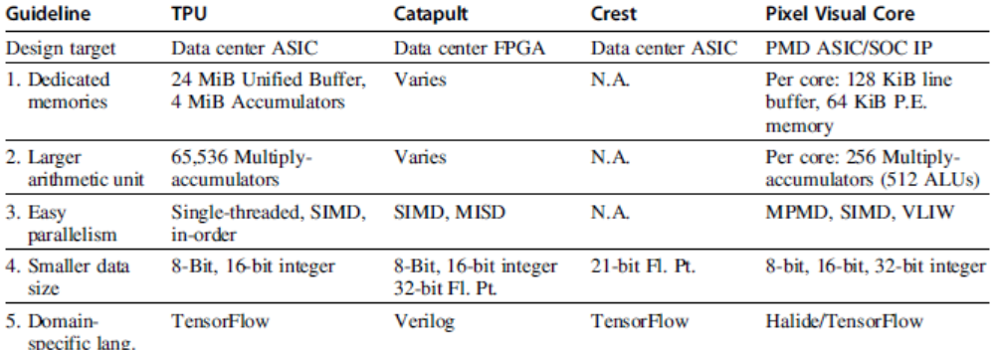
Guidelines for DSAs
Guidelines for DSAs

Slide 6
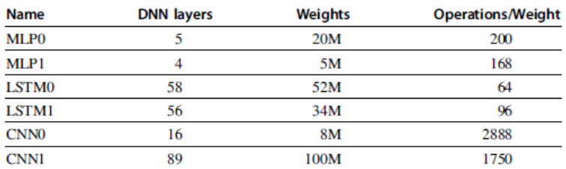
Example: Deep Neural Networks
Inpired by neuron of the brain
Computes non-linear “activiation” function of the weighted sum of input values
Neurons arranged in layers
Example: Deep Neural Networks

Slide 7
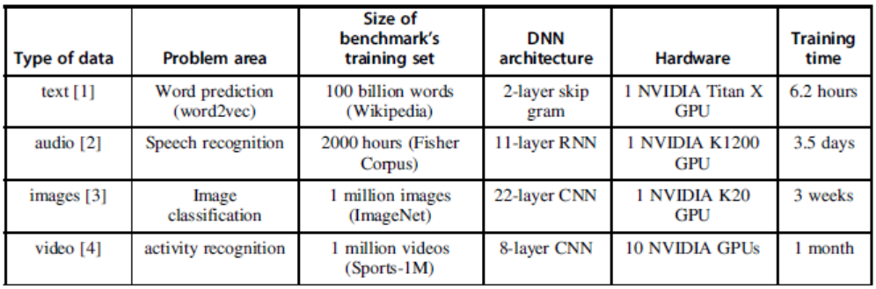
Example: Deep Neural Networks
Most practioners will choose an existing design
Topology
Data type
Training (learning):
Calculate weights using backpropagation algorithm
Supervised learning: stocastic graduate descent
Inferrence: use neural network for classification
Example: Deep Neural Networks

Slide 8
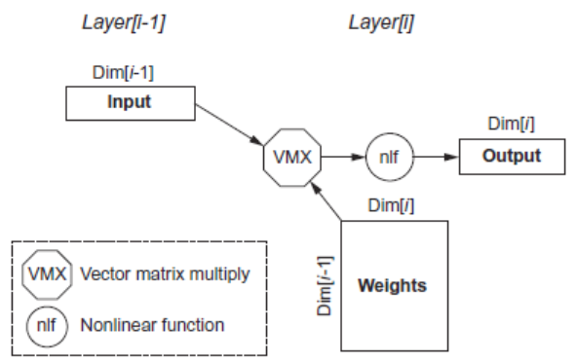
Multi-Layer Perceptrons
Parameters:
Dim[i]: number of neurons
Dim[i-1]: dimension of input vector
Number of weights: Dim[i-1] x Dim[i]
Operations: 2 x Dim[i-1] x Dim[i]
Operations/weight: 2
Example: Deep Neural Networks

Slide 9
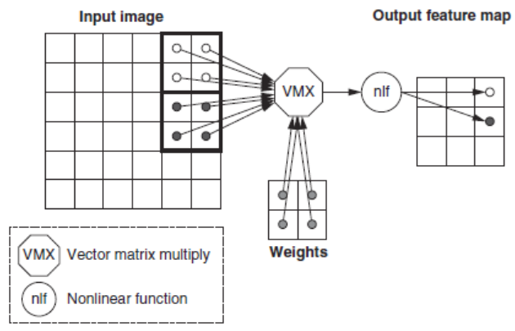
Convolutional Neural Network
Computer vision
Each layer raises the level of abstraction
First layer recognizes horizontal and vertical lines
Second layer recognizes corners
Third layer recognizes shapes
Fourth layer recognizes features, such as ears of a dog
Higher layers recognizes different breeds of dogs
Example: Deep Neural Networks

Slide 10
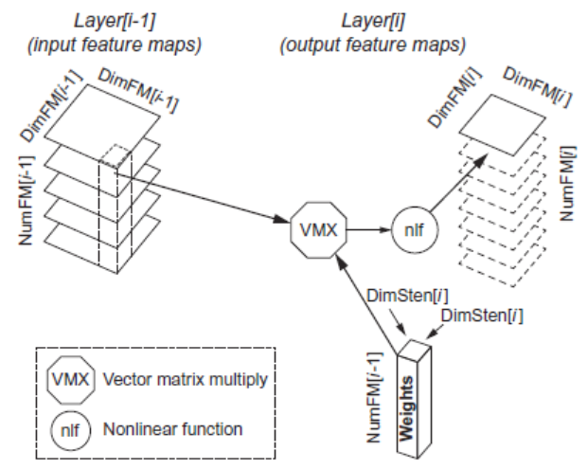
Convolutional Neural Network
Parameters:
DimFM[i-1]: Dimension of the (square) input Feature Map
DimFM[i]: Dimension of the (square) output Feature Map
DimSten[i]: Dimension of the (square) stencil
NumFM[i-1]: Number of input Feature Maps
NumFM[i]: Number of output Feature Maps
Number of neurons: NumFM[i] x DimFM[i]²
Number of weights per output Feature Map: NumFM[i-1] x DimSten[i]²
Total number of weights per layer: NumFM[i] x Number of weights per output Feature Map
Number of operations per output Feature Map: 2 x DimFM[i]² x Number of weights per output Feature Map
Total number of operations per layer: NumFM[i] x Number of operations per output Feature Map = 2 x DimFM[i]² x NumFM[i] x Number of weights per output Feature Map = 2 x DimFM[i]² x Total number of weights per layer
Operations/Weight: 2 x DimFM[i]²
Example: Deep Neural Networks

Slide 11
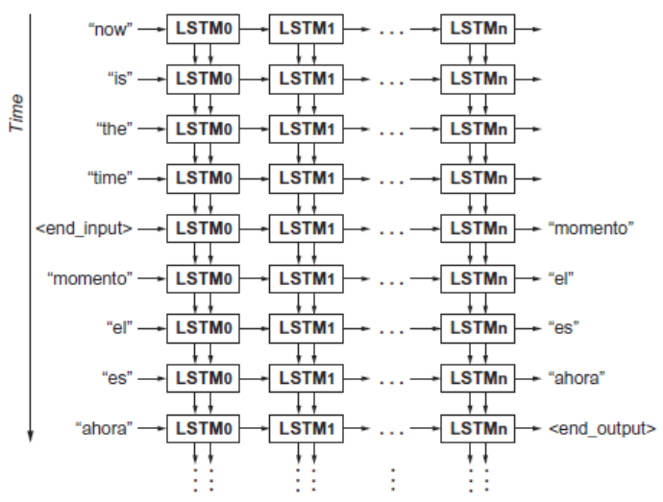
Recurrent Neural Network
Speech recognition and language translation
Long short-term memory (LSTM) network
Example: Deep Neural Networks

Slide 12
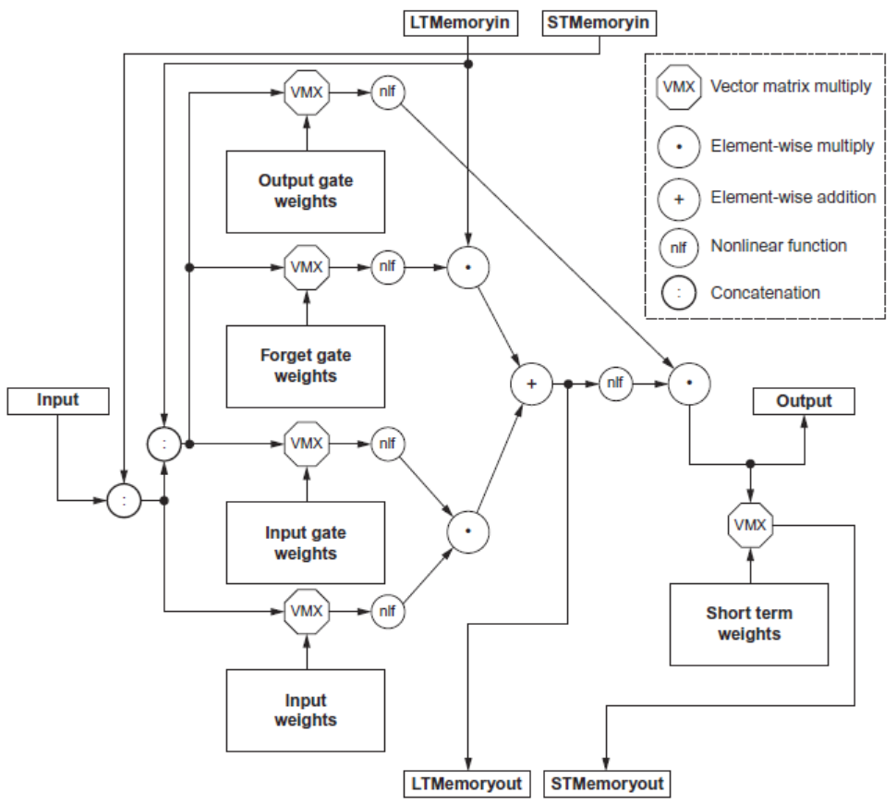
Recurrent Neural Network
Parameters:
Number of weights per cell: 3 x (3 x Dim x Dim)+(2 x Dim x Dim) + (1 x Dim x Dim) = 12 x Dim²
Number of operations for the 5 vector-matrix multiplies per cell: 2 x Number of weights per cell = 24 x Dim²
Number of operations for the 3 element-wise multiplies and 1 addition (vectors are all the size of the output): 4 x Dim
Total number of operations per cell (5 vector-matrix multiplies and the 4 element-wise operations): 24 x Dim² + 4 x Dim
Operations/Weight: ~2
Example: Deep Neural Networks

Slide 13
Convolutional Neural Network
Batches:
Reuse weights once fetched from memory across multiple inputs
Increases operational intensity
Quantization
Use 8- or 16-bit fixed point
Summary:
Need the following kernels:
Matrix-vector multiply
Matrix-matrix multiply
Stencil
ReLU
Sigmoid
Hyperbolic tangeant
Example: Deep Neural Networks

Slide 14
Tensor Processing Unit
Google’s DNN ASIC
256 x 256 8-bit matrix multiply unit
Large software-managed scratchpad
Coprocessor on the PCIe bus
Tensor Processing Unit

Slide 15
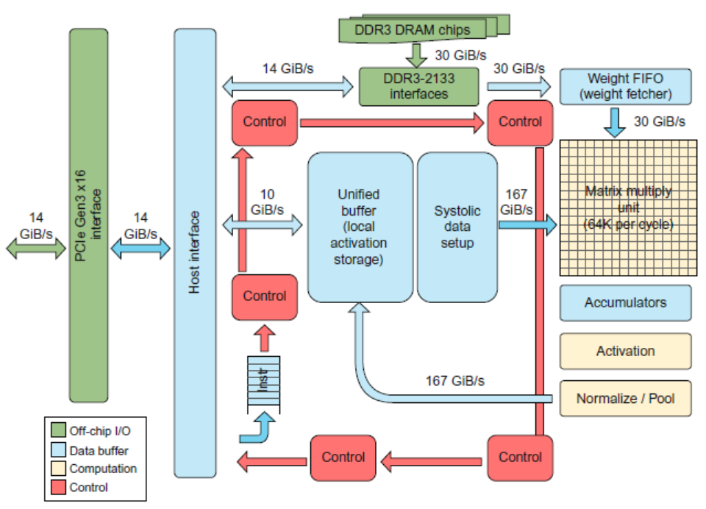
Tensor Processing Unit
Tensor Processing Unit

Slide 16
TPU ISA
Read_Host_Memory
Reads memory from the CPU memory into the unified buffer
Read_Weights
Reads weights from the Weight Memory into the Weight FIFO as input to the Matrix Unit
MatrixMatrixMultiply/Convolve
Perform a matrix-matrix multiply, a vector-matrix multiply, an element-wise matrix multiply, an element-wise vector multiply, or a convolution from the Unified Buffer into the accumulators
takes a variable-sized B*256 input, multiplies it by a 256x256 constant input, and produces a B*256 output, taking B pipelined cycles to complete
Activate
Computes activation function
Write_Host_Memory
Writes data from unified buffer into host memory
Tensor Processing Unit

Slide 17
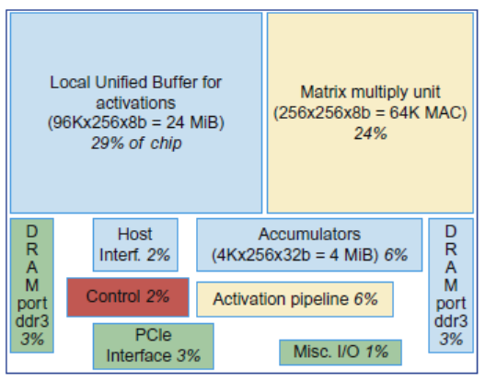
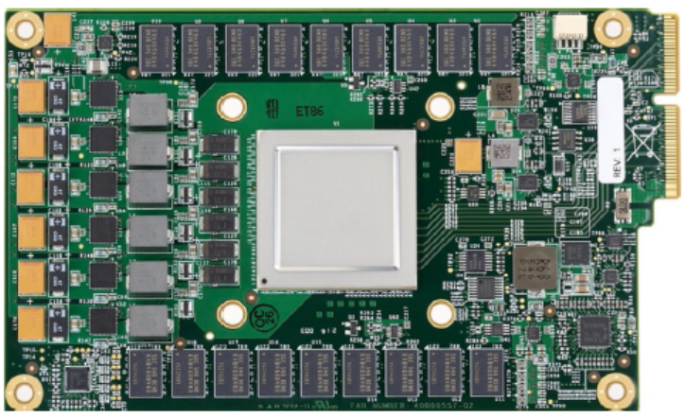
TPU ISA
Tensor Processing Unit

Slide 18
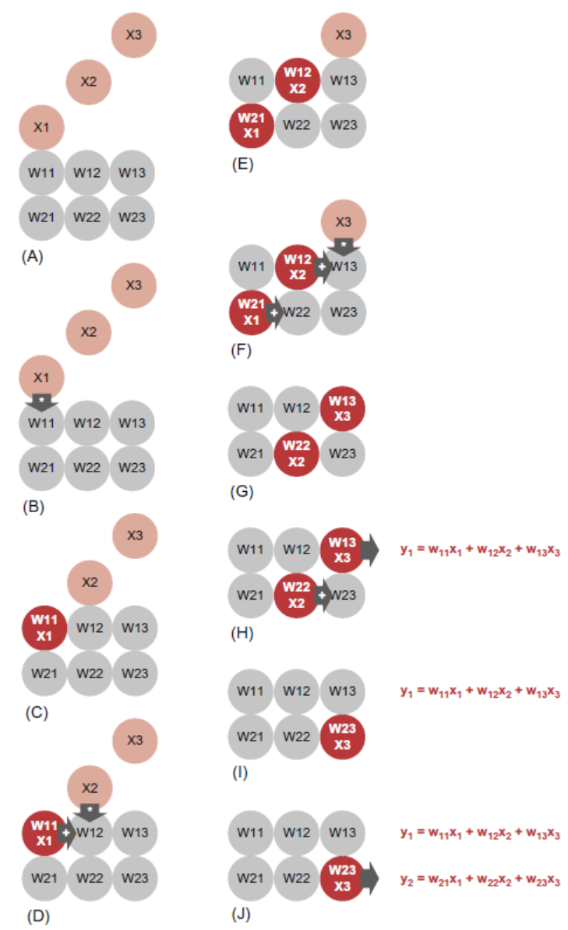
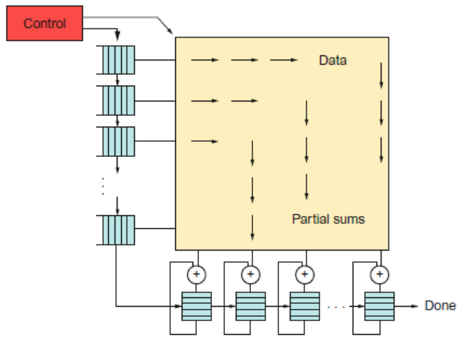
TPU ISA
Tensor Processing Unit

Slide 19
TPU ISA
Read_Host_Memory
Reads memory from the CPU memory into the unified buffer
Read_Weights
Reads weights from the Weight Memory into the Weight FIFO as input to the Matrix Unit
MatrixMatrixMultiply/Convolve
Perform a matrix-matrix multiply, a vector-matrix multiply, an element-wise matrix multiply, an element-wise vector multiply, or a convolution from the Unified Buffer into the accumulators
takes a variable-sized B*256 input, multiplies it by a 256x256 constant input, and produces a B*256 output, taking B pipelined cycles to complete
Activate
Computes activation function
Write_Host_Memory
Writes data from unified buffer into host memory
Tensor Processing Unit

Slide 20
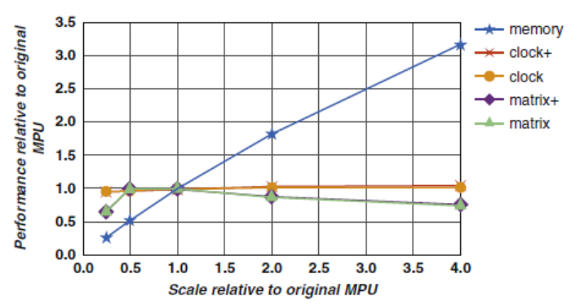
Improving the TPU
Tensor Processing Unit

Slide 21
The TPU and the Guidelines
Use dedicated memories
24 MiB dedicated buffer, 4 MiB accumulator buffers
Invest resources in arithmetic units and dedicated memories
60% of the memory and 250X the arithmetic units of a server-class CPU
Use the easiest form of parallelism that matches the domain
Exploits 2D SIMD parallelism
Reduce the data size and type needed for the domain
Primarily uses 8-bit integers
Use a domain-specific programming language
Uses TensorFlow
Tensor Processing Unit

Slide 22
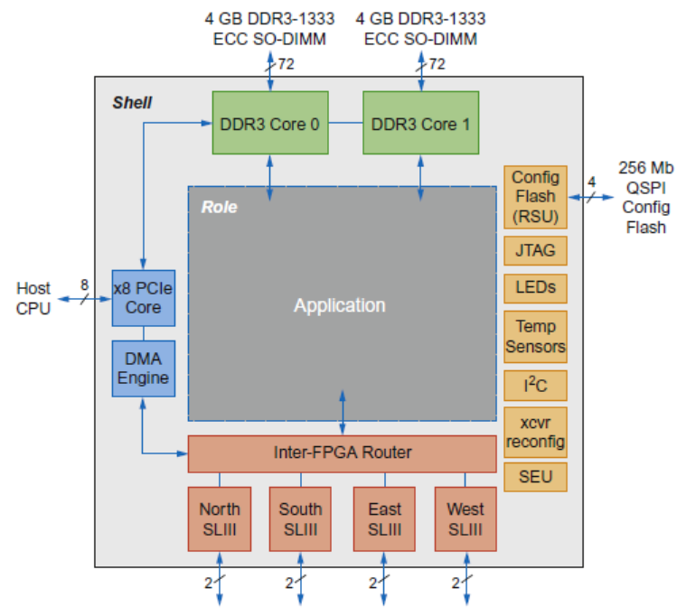
Microsoft Catapult
Microsoft Capapult
Needed to be general purpose and power efficient
Uses FPGA PCIe board with dedicated 20 Gbps network in 6 x 8 torus
Each of the 48 servers in half the rack has a Catapult board
Limited to 25 watts
32 MiB Flash memory
Two banks of DDR3-1600 (11 GB/s) and 8 GiB DRAM
FPGA (unconfigured) has 3962 18-bit ALUs and 5 MiB of on-chip memory
Programmed in Verilog RTL
Shell is 23% of the FPGA

Slide 23
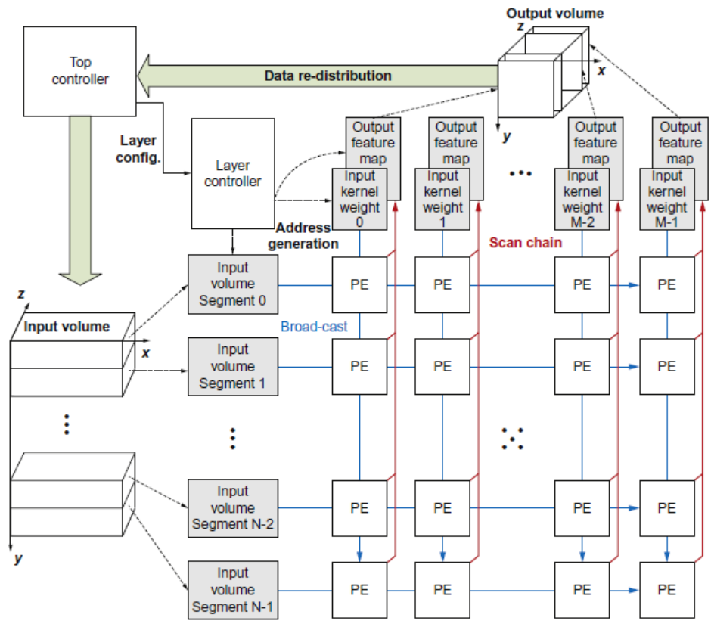
Microsoft Catapult: CNN
Microsoft Capapult
CNN accelerator, mapped across multiple FPGAs

Slide 24
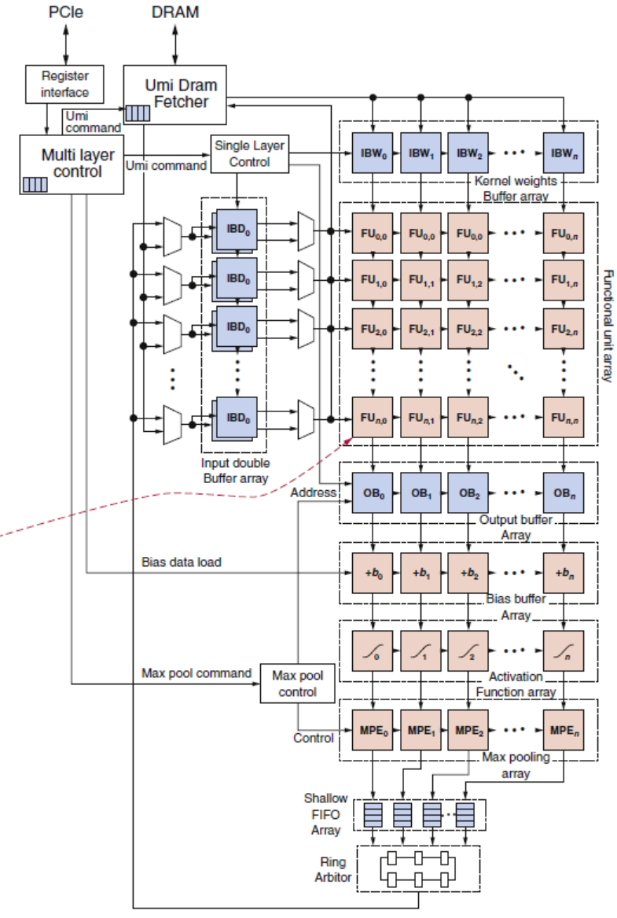
Microsoft Catapult: CNN
Microsoft Capapult

Slide 25
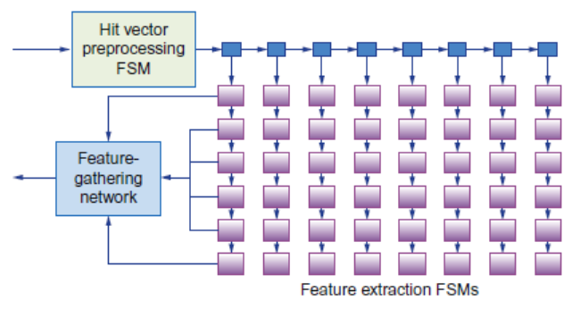
Microsoft Catapult: Search Ranking
Microsoft Capapult
Feature extraction (1 FPGA)
Extracts 4500 features for every document-query pair, e.g. frequency in which the query appears in the page
Systolic array of FSMs
Free-form expressions (2 FPGAs)
Calculates feature combinations
Machine-learned Scoring (1 FPGA for compression, 3 FPGAs calculate score)
Uses results of previous two stages to calculate floating-point score
One FPGA allocated as a hot-spare

Slide 26
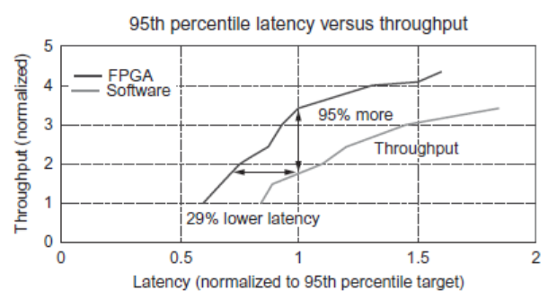
Microsoft Catapult: Search Ranking
Microsoft Capapult
Free-form expression evaluation
60 core processor
Pipelined cores
Each core supports four threads that can hide each other’s latency
Threads are statically prioritized according to thread latency

Slide 27
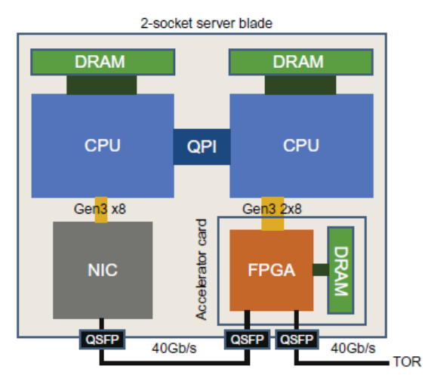
Microsoft Catapult: Search Ranking
Microsoft Capapult
Version 2 of Catapult
Placed the FPGA between the CPU and NIC
Increased network from 10 Gb/s to 40 Gb/s
Also performs network acceleration
Shell now consumes 44% of the FPGA
Now FPGA performs only feature extraction

Slide 28
Catapult and the Guidelines
Microsoft Capapult
Use dedicated memories
5 MiB dedicated memory
Invest resources in arithmetic units and dedicated memories
3926 ALUs
Use the easiest form of parallelism that matches the domain
2D SIMD for CNN, MISD parallelism for search scoring
Reduce the data size and type needed for the domain
Uses mixture of 8-bit integers and 64-bit floating-point
Use a domain-specific programming language
Uses Verilog RTL; Microsoft did not follow this guideline

Slide 29
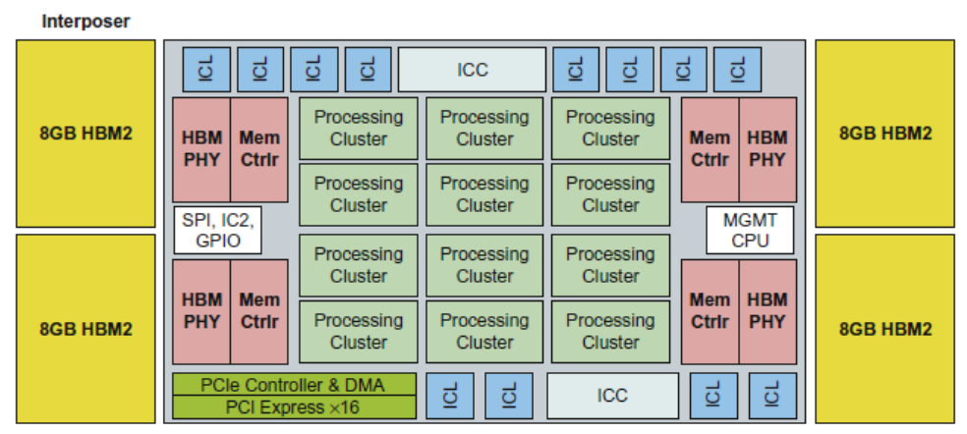
Intel Crest
Intel Crest
DNN training
16-bit fixed point
Operates on blocks of 32x32 matrices
SRAM + HBM2

Slide 30
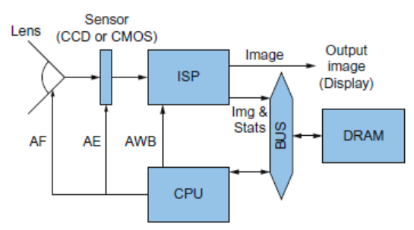
Pixel Visual Core
Pixel Visual Core
Pixel Visual Core
Image Processing Unit
Performs stencil operations
Decended from Image Signal processor

Slide 31
Pixel Visual Core
Pixel Visual Core
Software written in Halide, a DSL
Compiled to virtual ISA
vISA is lowered to physical ISA using application-specific parameters
pISA is VLSI
Optimized for energy
Power Budget is 6 to 8 W for bursts of 10-20 seconds, dropping to tens of milliwatts when not in use
8-bit DRAM access equivalent energy as 12,500 8-bit integer operations or 7 to 100 8-bit SRAM accesses
IEEE 754 operations require 22X to 150X of the cost of 8-bit integer operations
Optimized for 2D access
2D SIMD unit
On-chip SRAM structured using a square geometry

Slide 32
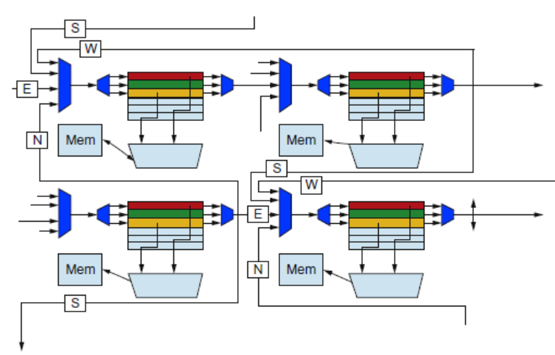
Pixel Visual Core
Pixel Visual Core

Slide 33
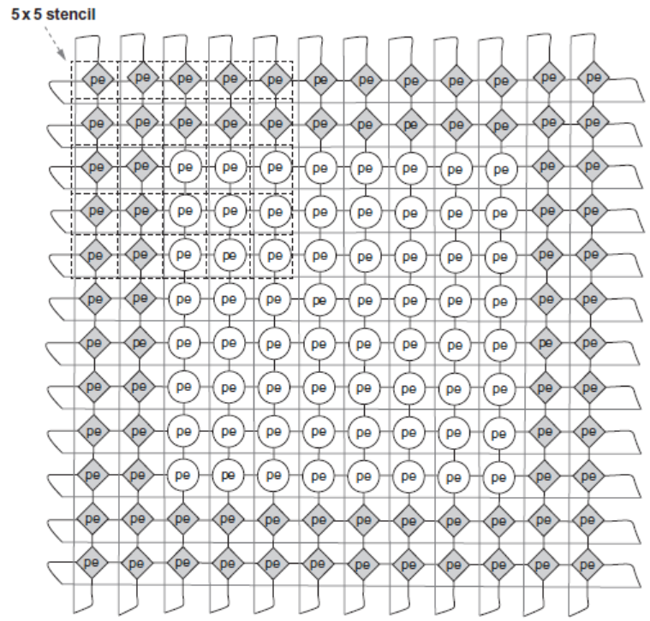
Pixel Visual Core
Pixel Visual Core

Slide 34
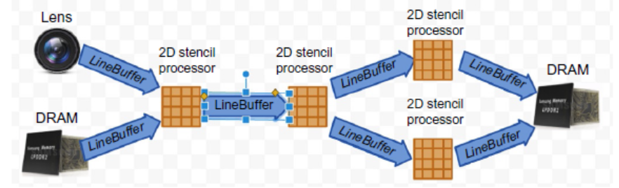
Pixel Visual Core
Pixel Visual Core

Slide 35
Visual Core and the Guidelines
Microsoft Capapult
Use dedicated memories
128 + 64 MiB dedicated memory per core
Invest resources in arithmetic units and dedicated memories
16x16 2D array of processing elements per core and 2D shifting network per core
Use the easiest form of parallelism that matches the domain
2D SIMD and VLIW
Reduce the data size and type needed for the domain
Uses mixture of 8-bit and 16-bit integers
Use a domain-specific programming language
Halide for image processing and TensorFlow for CNNs

Slide 36
Fallacies and Pitfalls
Microsoft Capapult
It costs $100 million to design a custom chip
Performance counters added as an afterthought
Architects are tackling the right DNN tasks
For DNN hardware, inferences per second (IPS) is a fair summary performance metric
Being ignorant of architecture history when designing an DSA

